Slide 1
Chapter 1
Web Services Basics
Mike P. Papazoglou
mikep@uvt.nl

Slide 2
Topics
Introduction – definitions
Software as a service
Where can services be used?
Characteristics of web services
Web services interfaces and implementations
Service-oriented architecture
Web services technology stack
Quality of service
Impact and shortcomings of Web services

Slide 3
Service-Oriented Paradigm
The service-oriented paradigm to programming utilizes services as the constructs to support the development of rapid, low-cost and easy composition of distributed applications.
A Web service is a programmatically available application logic exposed over the Internet.
  Any piece of code and any application component deployed on a system can be transformed into a network-available service.
Services reflect a new ‘service-oriented’ approach to programming, based on the idea of composing applications by discovering and invoking network-available services rather than building new applications or by invoking available applications to accomplish some task.

Slide 4
What are Web Services?
Web services perform encapsulated business functions such as:
a self-contained business task – a funds withdrawal or funds deposit service;
a full-fledged business process – the automated purchasing of office supplies;
an application – a life insurance application or demand forecasts and stock replenishment; or
a service-enabled resource – access to a particular back-end database containing patient medical records.

Slide 5
What are Web Services?
Can be mixed and matched to create a complete process:
  Enable integration with decreased human interaction, e.g., create complete enterprise processes, such as supply chain management, procurement, logistics, etc.
  Both new and extensions to existing applications
Available to a variety of clients (platform independent)
Pricing (rating) model determines subscriber rates based on subscription and usage events, e.g., calculate charges for services based on the quality and precision of the service.
Billing model:
    “pay per use”, “lease it”, “pay for it” basis.

Slide 6
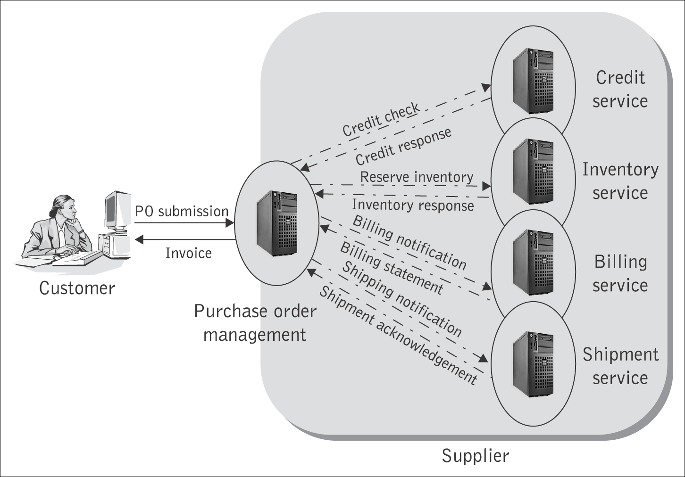
A purchase order application involving interacting web services

Slide 7
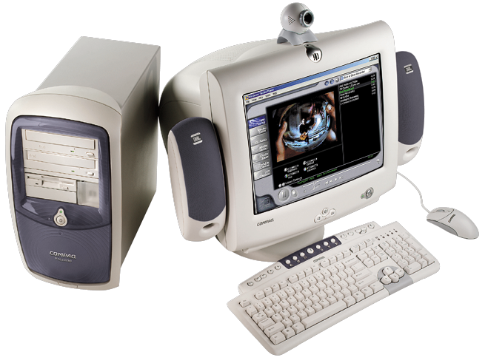
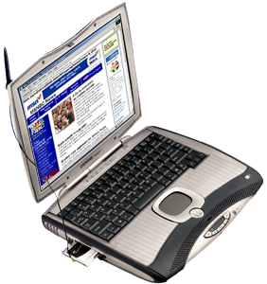
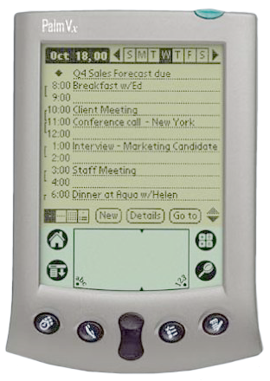

A Supply Chain application
Warehouse management
application
Supply
planning
application
+
+
+
+
+
+
+
+
INTERNET
Shipment
Logistics
Demand
planning
Inventory
Replenishment
Distribution planning

Slide 8
Topics
Introduction – definitions
Software as a service
Where can services be used?
Characteristics of web services
Web services interfaces and implementations
Service oriented architecture
Web services technology stack
Quality of service
Impact and shortcomings of web services

Slide 9
Application Service Providers
The concept of software-as-a-service is evolutionary and appeared first with the ASP (application service provider) software model:
  An ASP “rents” applications to subscribers.
  The whole application is developed in terms of the user interface, workflow, business, and data components that are all bound together to provide a working solution.
  An ASP hosts the entire application and the customer has little opportunity to customize it beyond the appearance of the user interface, e.g., adding company logos.
  An alternative of this is where the ASP is providing a software module that is downloaded to the customer’s site on demand – this is for situations where the software does not work in a client/server fashion, or can be operated remotely via a browser.
Source: Includes Everware-CBDI copyright materials

Slide 10
ASP vs. Web Services
Although the ASP model introduced the concept of software- as-a-service first, it suffered from several inherent limitations such as
  inability to develop highly interactive applications;
  inability to provide complete customizable applications and;
  inability to integrate applications.
Today we are in the midst of another significant development in the evolution of software-as-a-service. The new architecture allows for:
  loosely coupled asynchronous interactions
  on the basis of eXtensible Markup Language (XML) standards
  with the intention of making access to, and communications between, applications over the Internet easier, by means of appropriate standards.

Slide 11
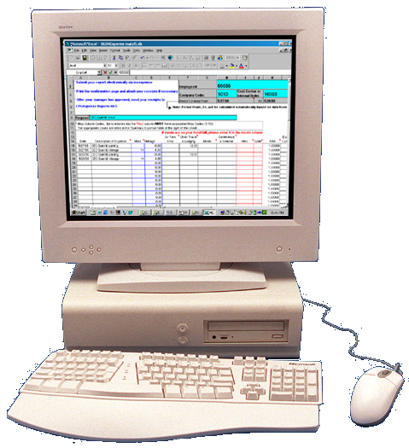
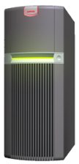
Are ASP, Software-as-a-Service, and Web Service the same?
Customer
Application solution provider
Name
View in browser
No.
Name
Zip
No.
State
Zip
OK
Cancel
Typical ASP
State
OK
Cancel
Application runs here
Download on demand
Name
Name
No.
No.
Zip
Zip
State
State
OK
Cancel
OK
Cancel
Application runs here
Software as a Service
Name
Access service
No.
Zip
State
OK
Cancel
Web services
Application runs partly here
(composition, repackaging, differentiation,
value-added services)
Application runs partly
here
Adapted from: CBDi forum copyright Everware-CBDI
Notes:
There are many different topologies that are now available to us.
However, terminology is often used very loosely
It is easy to confuse someone by describing a ‘service’ as a Web Service when it is in fact not.
Application Solution Providers (ASP) today typically provide a complete solution. The whole application in terms of the UI, workflow, business and data components is all bound together to provide a working solution.
The entire application is hosted by them, and the customer has little opportunity to customize it beyond set up tables, or perhaps the final appearance of the UI (such as adding Logos)
Access to the application for the customer is simply via a browser. Or they might download reports.
This is not a very flexible solution – but offers considerable benefits in terms of deployment providing the customer is willing to accept it ‘as is’
An alternative of this is where the ASP is providing a software that is downloaded to the customers machine on demand – this is for situations where the software does not work in a client/server fashion, or can be operated remotely via a browser.
The software might be deleted at the end of the session, or may remain on the customers machine until replaced by a new version, or the contract for using it expires.
In many respects this is no different to ‘traditional’ methods of installing a piece of software from say a CD-ROM. However, this form of deployment from the ASP can be automated, reducing software deployment costs, though not saving the customer any hardware costs.
The use of Web services provides a more flexible solution. The core of the application – the business and data components remain on the ASP’s machines, but are now accessed programmatically via Web service interfaces.
The customer can now build their own custom business process and UI, and may also be free to select from a variety of Web services that comply to a business standard from a number of alternative ASPs.

Slide 12
Topics
Introduction – definitions
Software as a service
Where can services be used?
Characteristics of web services
Web services interfaces and implementations
Service oriented architecture
Web services technology stack
Quality of service
Impact and shortcomings of web services

Slide 13



What problems do we solve?
A mid-sized manufacturer needs to create online relationships with customers, each with their own set of standard and protocols.
Broader
B2B
Describe services
Search
capabilities
To meet its on-time delivery commitments a high-tech manufacturer needs to place orders with the most advantageous parts manufacturer or assembler.
Discover
services
A high-tech manufacturer needs to easily integrate and synchronize third-party providers with its
manufacturing and distribution requirements.
Integrate
services
together
Easier
aggregation

Slide 14
Where are Services used?
Within an enterprise (enterprise application integration)
  Accelerate and reduce the cost of integration
  Save on infrastructure deployment and management costs
  Reduce skill requirements
  Improve reuse
Between enterprises (e-Business integration)
  Providing service to a company’s customers
    e.g., an Insurance company wishes to link its systems to the systems of a new institutional customer
  Accessing services from a company’s partners and suppliers
    e.g., dynamically link to new partners and suppliers to offer their services to complement the value the company provides
  Standards and common infrastructure reduce the barriers
  Simplicity accelerates deployment
  Dynamics opens new business opportunities

Slide 15
Topics
Introduction – definitions
Software as a service
Where can services be used?
Characteristics of web services
Web services interfaces and implementations
Service oriented architecture
Web services technology stack
Quality of service
Impact and shortcomings of web services

Slide 16
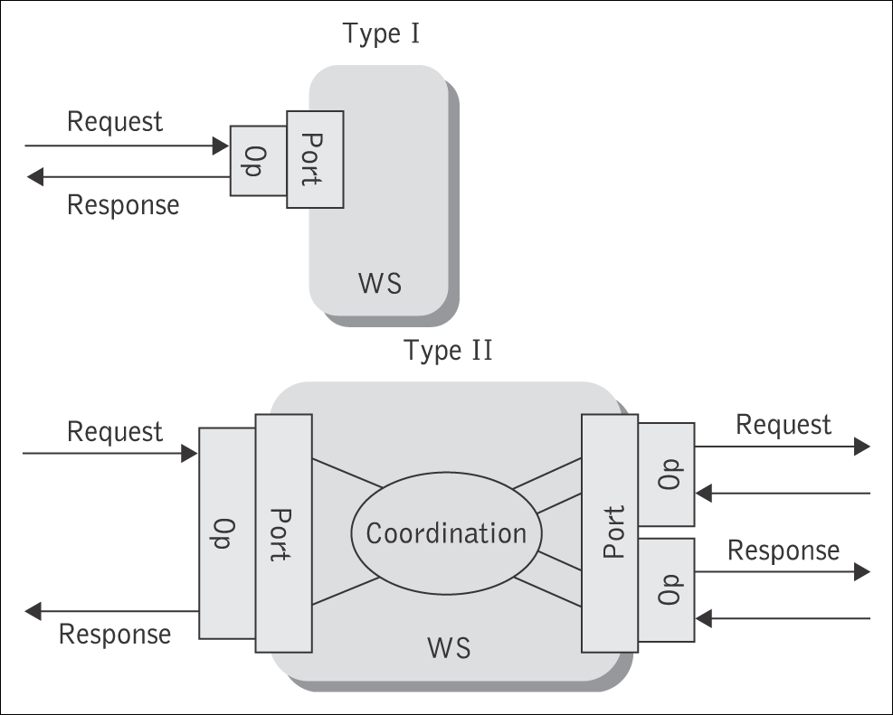
Types of Web Services
Informational services are services of relatively simple nature. They either provide access to content interacting with an end-user by means of simple request/response sequences, or expose back-end business applications to other applications. Examples include:
  content services such as weather report info.,
  simple financial info., stock quote info., news items
  simple trading services that can provide
  a seamless aggregation of information across
  disparate systems and data sources.
Complex services that involve the assembly and
invocation of many pre-existing services
possibly found in diverse enterprises to
complete a multi-step business interaction:
  a supply-chain application involving order taking,
  stocking orders, sourcing, inventory control,
  financials, and logistics.

Slide 17
Service Properties and State
Functional and non-functional properties:
  The functional service description details the operational characteristics that define the overall behavior of the service.
  The non-functional description targets service quality attributes, e.g., service metering and cost, performance metrics (response time or accuracy), security, authorization, authentication, scalability, availability, etc.
Stateless or stateful services:
  Services that can be invoked repeatedly without having to maintain context or state they are called stateless.
    Simple informational services are stateless.
  Services that require their context to be preserved from one invocation to the next are called stateful.
    Complex services (business processes) typically involve stateful interactions.

Slide 18
Loose Coupling and Granularity
Loose coupling:
  Coupling indicates the degree of dependency any two systems have on each other.
  Web services are loosely coupled: they connect and interact more freely (across the Internet). They need not know how their partner applications behave or are implemented.
Service granularity:
  Simple services are discrete in nature, exhibit normally a request/reply mode of operation and are of fine granularity, i.e., they are atomic in nature.
  Complex services are coarse-grained, e.g., a SubmitPurchaseOrder process. These involve interactions with other services and possibly end-users in a single or multiple sessions.
  Coarse-grained communication implies larger and richer data structures (viz. those supported by XML).

Slide 19
Synchronicity and Well-definedness
Sychronicity: There are two programming styles for services:
  Synchronous or remote procedure call (RPC)-style: Clients of synchronous services express their request as a method call with a set of arguments, which returns a response containing a return value.
    Simple informational services, e.g., returning the current price for a given stock; providing the current weather conditions in a particular location; or checking the credit rating of a potential trading partner.
  Asynchronous or message (document)-style: When a client invokes a message-style service, it typically sends it an entire document, e.g., a purchase order, rather than a discrete set of parameters.
    Business processes, e.g., processing a purchase order; responding to a request for quote order from a customer; or responding to an order placement by a particular customer.
Well-definedness:
  The service interaction must be well- defined. The web services
  description language (WSDL) allows applications to describe the rules for interfacing and interacting to other applications.

Slide 20
Topics
Introduction – definitions
Software as a service
Where can services be used?
Characteristics of web services
Web services interfaces and implementations
Service oriented architecture
Web services technology stack
Quality of service
Impact and shortcomings of web services

Slide 21
Service Interface and Implementation
The service interface defines service functionality visible to the external world and provides the means to access this functionality.
  The service describes its own interface characteristics, i.e., the operations available, the parameters, data-typing and the access protocols, in a way that other software modules can determine what it does, how to invoke its functionality, and what result to expect in return.
The service implementation realizes a specific service interface whose implementation details are hidden from its users.
  Different service providers using any programming language of their choice may implement the same interface.

Slide 22
Client vs. provider perspective
What does it do?
How to represent it (business requs)
How to build it
Interface
Implementation
How do I use it?
Where can I find it?
Where to host it
How to publish it
Client perspective
Provider perspective

Slide 23
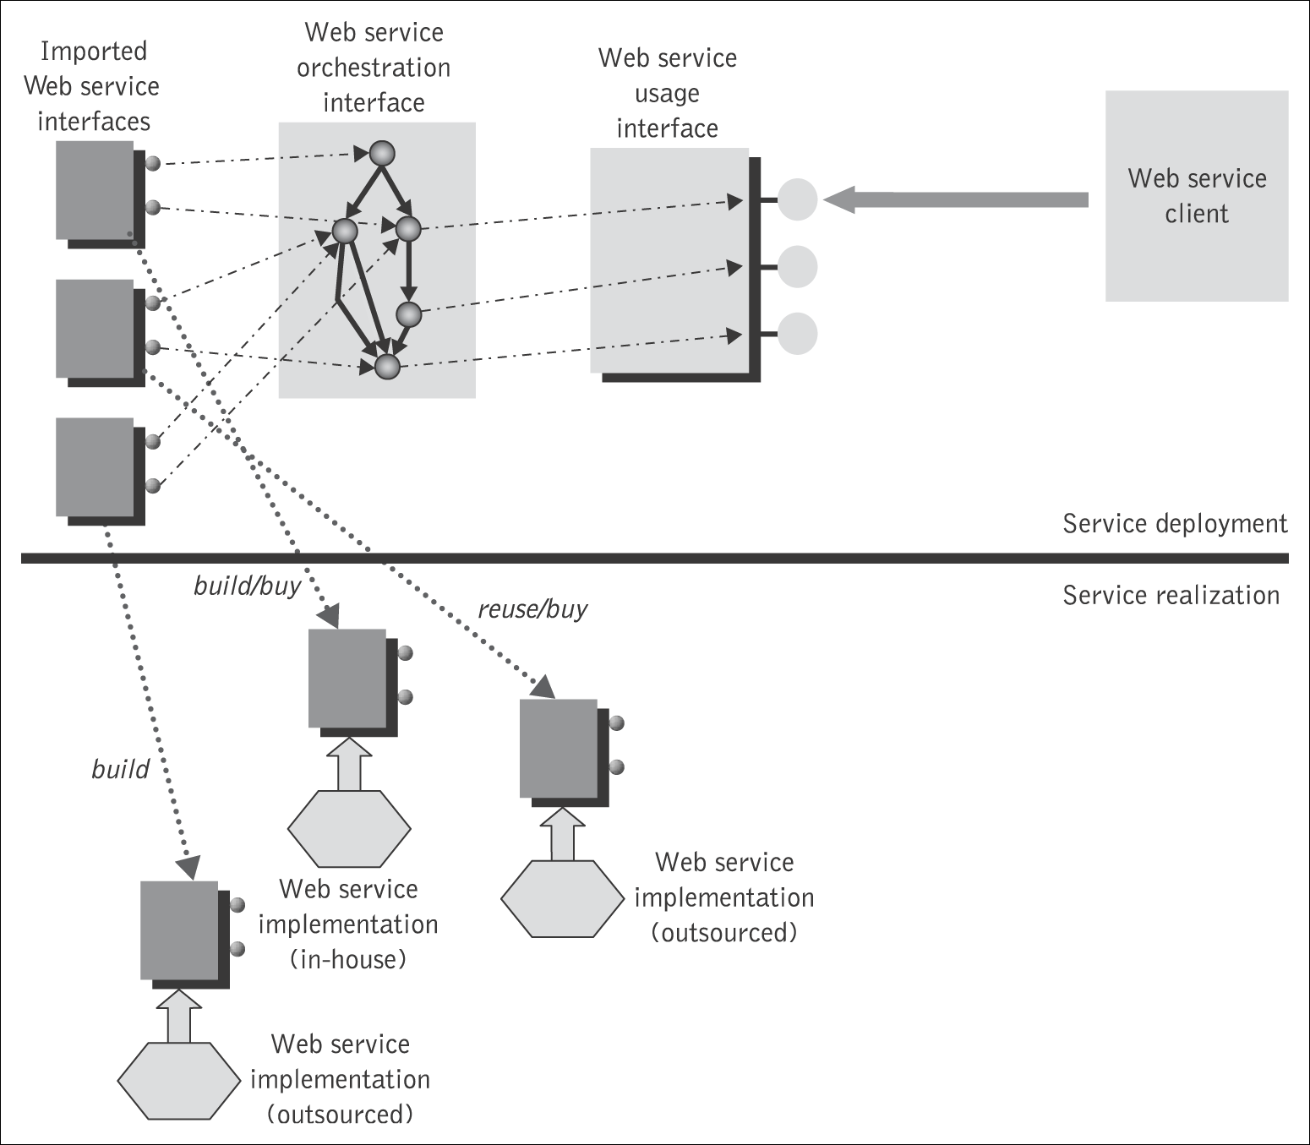
Service deployment vs. service realization

Slide 24
Topics
Introduction – definitions
Software as a service
Where can services be used?
Characteristics of web services
Web services interfaces and implementations
Service oriented architecture
Web services technology stack
Quality of service
Impact and shortcomings of web services

Slide 25
Roles
The service model allows for a clear distinction to be made between
  service providers (organizations that provide the service implementations, supply their service descriptions, and provide related technical and business support);
  service clients (end-user organizations that use some service);
  service registry (a searchable directory where service descriptions can be published and searched).
    Service requestors find service descriptions in the registry and obtain binding information for services.
    This information is sufficient for the service requestor to contact, or bind to, the service provider and thus make use of the services it provides.

Slide 26
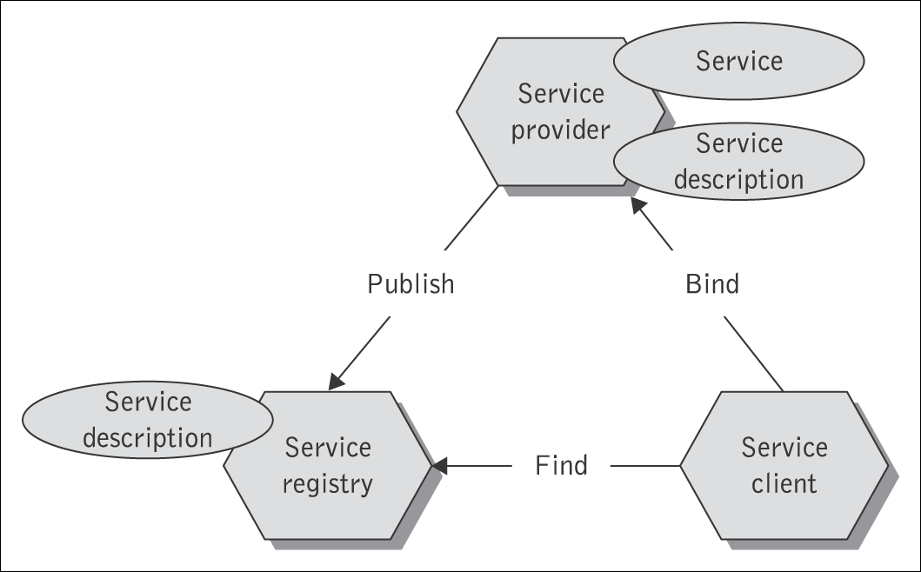
Service-Oriented Architecture
SOA is a logical way of designing a software system to provide services to either end-user applications or to other services distributed in a network, via published and discoverable interfaces.

Slide 27
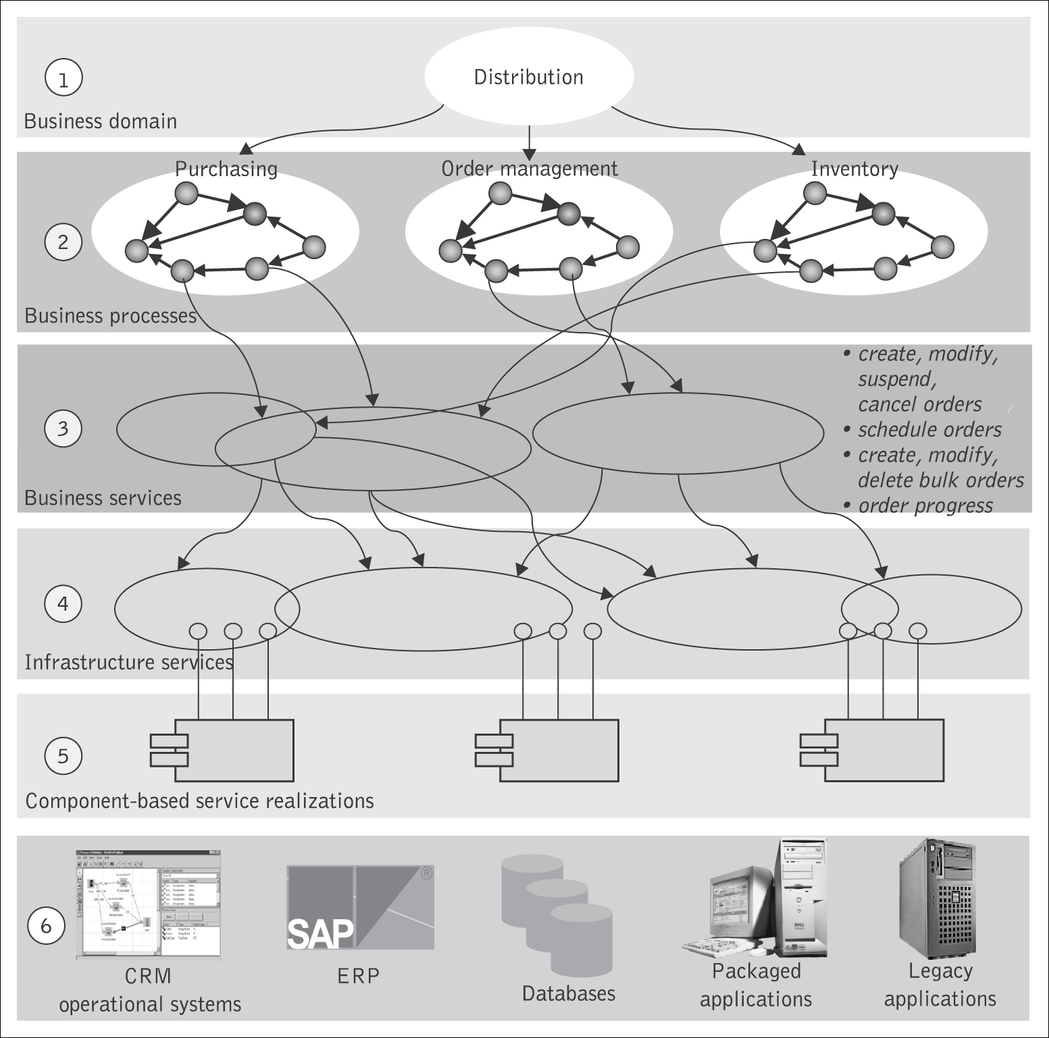
Layers in an SOA

Slide 28
Topics
Introduction – definitions
Software as a service
Where can services be used?
Characteristics of web services
Web services interfaces and implementations
Service oriented architecture
Web services technology stack
Quality of service
Impact and shortcomings of web services

Slide 29
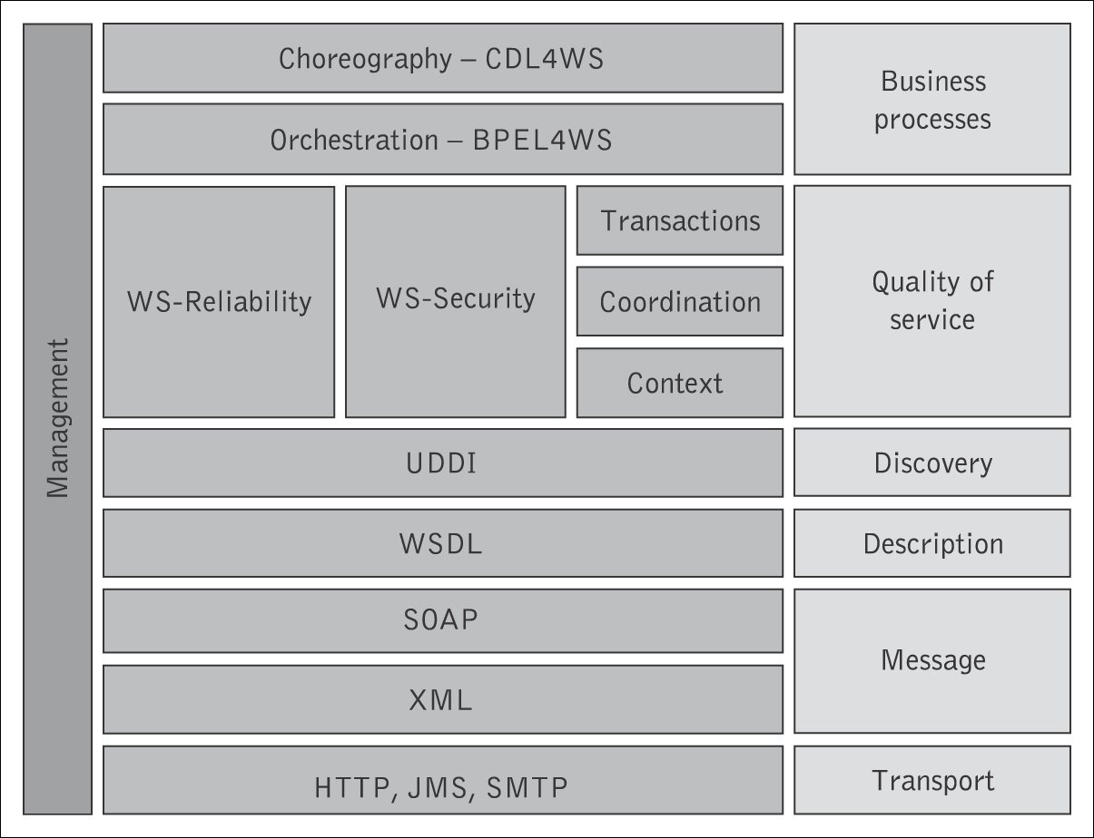
Web Services Technology Stack
Web services are implemented by a collection of several related technologies and standards.

Slide 30
Topics
Introduction – definitions
Software as a service
Where can services be used?
Characteristics of web services
Web services interfaces and implementations
Service oriented architecture
Web Services technology stack
Quality of service
Impact and shortcomings of web services

Slide 31
Quality of Service (QoS)
QoS refers to the ability of a Web service to respond to expected invocations and perform them at the level commensurate to the mutual expectations of both its provider and its customers.
The key QoS in a Web services environment are:
  availability
  accessibility
  conformance to standards
  integrity
  performance
  reliability
  scalability
  security
  Transactionality.

Slide 32
Service Level Agreements (SLAs)
An SLA is a formal agreement (contract) between a provider and client, formalizing the details of use of a Web service (contents, price, delivery process, acceptance and quality criteria, penalties, etc in measurable terms) in a way that meets the mutual understandings and expectations of both providers and clients.
An SLA may contain the following parts:
  purpose
  parties
  validity period
  scope
  restrictions
  service-level objectives
  penalties
  exclusion terms
  administration authority.

Slide 33
Topics
Introduction – definitions
Software as a service
Where can services be used?
Characteristics of web services
Web services interfaces and implementations
Service oriented architecture
Web services technology stack
Quality of service
Impact and shortcomings of web services

Slide 34
Impact of Web Services
The most appealing characteristic of Web services is that they are evolving to embrace the convergence of e-Business, EAI, traditional middleware, and the Web. Web services offer:
  a standard way to expose legacy application functionality as a set of reusable services;
  a standard, easy, and flexible way to help overcome application integration issues;
  a standard way to develop and/or assemble Internet-native applications for both the internal and the extended enterprise;
  a common facade for cross-enterprise specific systems, making it easier to create the service-level agreements needed for business-to-business integration.

Slide 35
Pitfalls of Web Services
As the business requirements that drive Web services become even more complex, Web services technologies require additional capabilities to handle demanding situations that severely test the most obvious current shortcomings of Web services. These include:
  performance issues,
  lack of appropriate support for sophisticated transaction management,
  lack of expressing business semantics and, especially,
  achieving a widespread agreement and harmonization on a wide range of existing and emerging standards.
    There is an overwhelming number of existing and emerging standards.
    Unless these standards mature enough to the degree that they are harmonized and can act together, the long-term viability of Web services applications being used in mission-critical, production environments will be severely tested.

